Slide 1
Propulsion PDR
Project Manager: Cameron Flannery
Deputy Project Manager: Bill Lieu

Slide 2
Agenda
Motor Overview
Nozzle Overview
Dimensions
Thermal
Fluid Flow
Avionics Integration
Chamber Pressure
Camera and Antenna Mount
Section Adapter
Risks

Slide 3
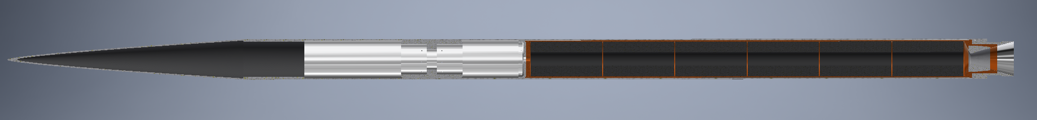
Vehicle Overview (Major Components)
17’
7’8”
Nosecone
Recovery System
6 BATES grains
Avi-bay
Section Adapter
Ablative Nozzle
General
2 piece aluminum airframe
Aluminum section adapter
¾ power series nosecone
Carbon fiber
Note: Fins still under design review
Propulsion
Q-Class Motor
APCP (Aluminum Fuel/Ammonium Perchlorate Oxidizer)
Ablatively cooled nozzle
BATES grains

Slide 4
Motor Overview
Q-class motor
6 BATES Grains
APCP Propellant (Aluminum Fuel)

Slide 5
Thrust
Q-motor
Impulse range: 18,400-36,800
Intrepid motor: 27600

Slide 6
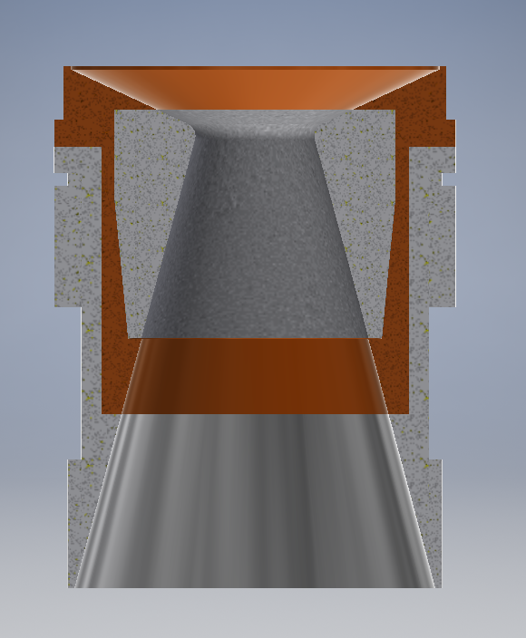
Nozzle Overview
Phenolic
(2-pieces)
Graphite Throat
Aluminum Retainer
Aluminum Carrier
Aluminum Skirt

Slide 7
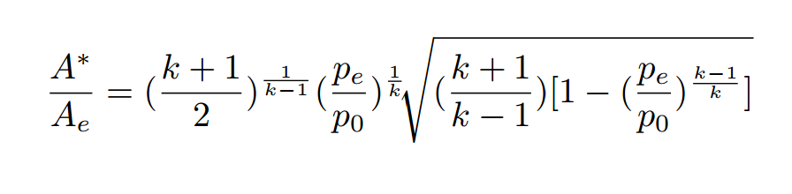
Dimensioning
2.30”
Calculating Optimal Expansion Ratio*:
Ideal**: 6.894 – calculated with combustion products properties
Actual: 2.934
Under-expansion results from manufacturing capabilities
Exact impact on performance is difficult to calculate due to liquid combustion products (Al)
Performance decrease of ~5% expected
6.75”
*equation from Rocket Propulsion Elements
** at sea-level

Slide 8
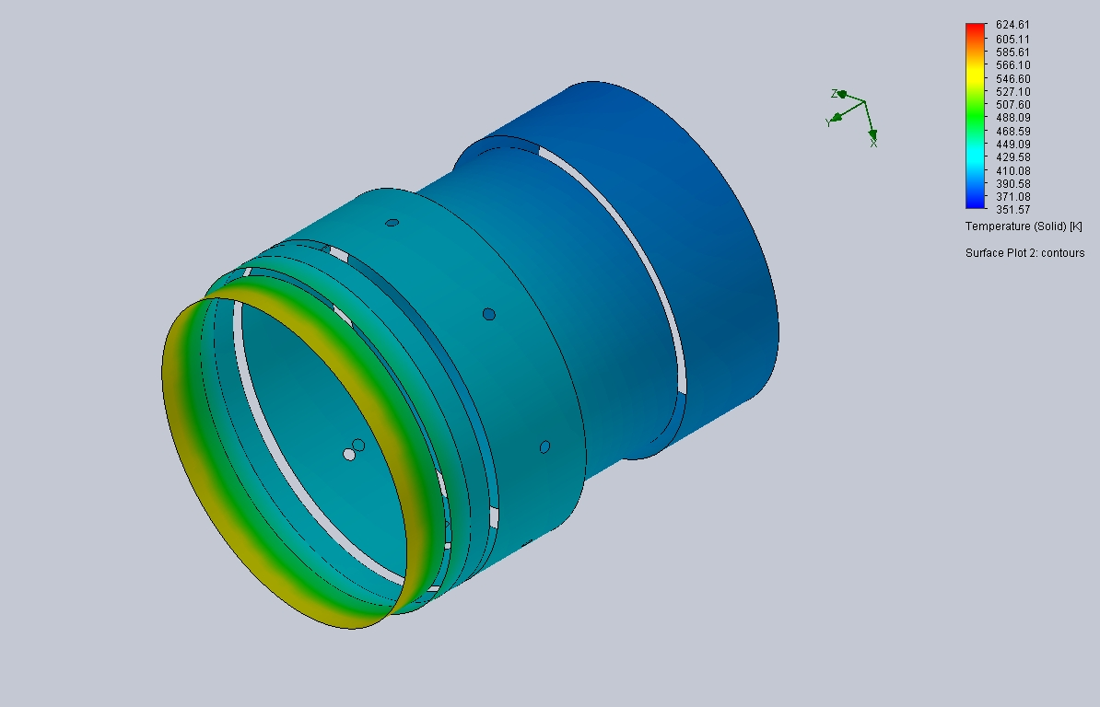

Nozzle Design – Stresses
Material Properties:
Phenolic Liner: Liner thickness; ¼”
Heat Transfer Through Phenolic Liner: $0.15\frac{W}{m∗K}$
Nozzle Al reaches max(T) ~ 580 K
1” of Al material thickness at hottest point
Yield Strength: 35,000 psi
Max Hoop Stress: 2,437 psi
F.S. > 14

Slide 9
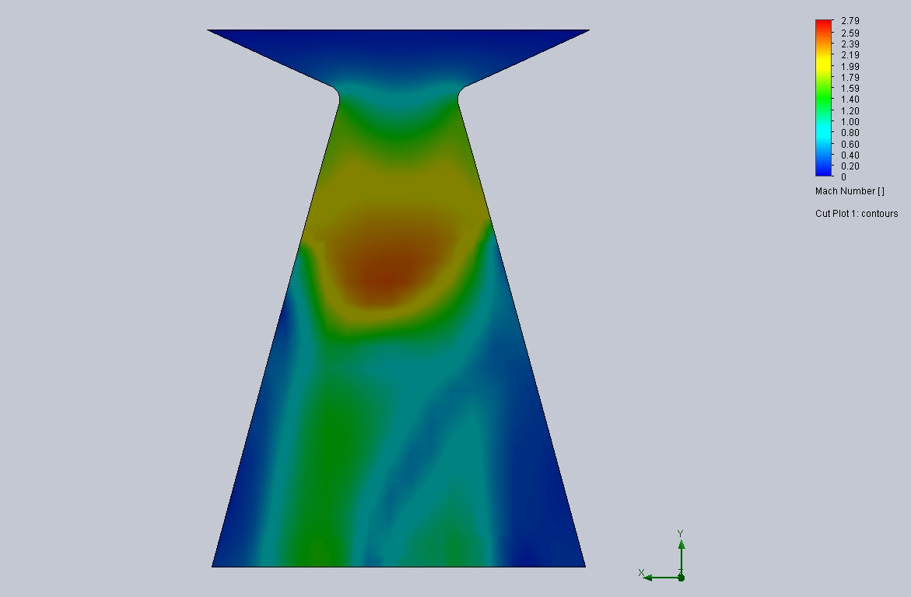
Nozzle Design – Fluid Flow
Aim:
Prevent cavitation
Prevent separation of flow
Analysis:
CFD Analysis
Assumes gaseous combustion products
Results in approximately 10% error due to aluminum in propellant

Slide 10
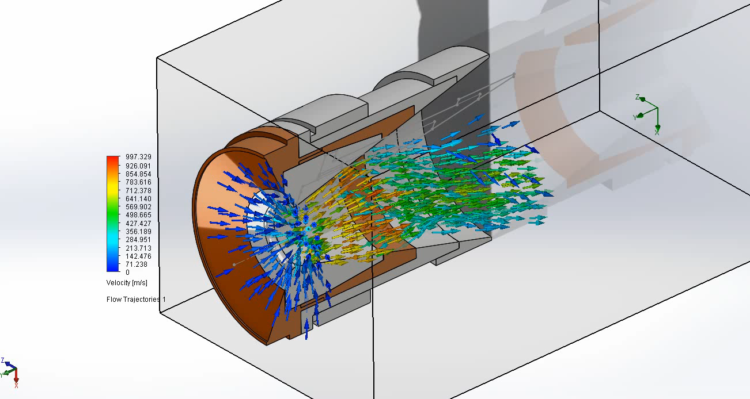
Nozzle Design – Fluid Analysis

Slide 11
Design for Manufacturability
6061 Series Aluminum
Phenolic and graphite relatively simple to machine
Cone Nozzle:
Easy to machine with a lathe
No crazy contours
Drawings created with GD&T for each part

Slide 12
Risks & Issues
Over-expansion is not quantified
Solution: is to perform a static fires at sea-level with different expansion ratios
Cavitation and Separation of Flow
Phenolic Thermal Barrier
Melting point below temp of chamber
Solution: replace phenolic with carbon at nozzle entry

Slide 13
BACKUP SLIDES

